Slide 1

Toxins and Targets
Supervised By
Dr.Tayseer Hassan

Slide 2


Team Members:
① Habeba Allah Adnan Ahmed
② Reem Osama Abd-El Moneim
③ Mohamed Medhat Abd-El Rady
④ Amr Mohamed Gaber
⑤ Mohamed Ehab Mohamed

Slide 3
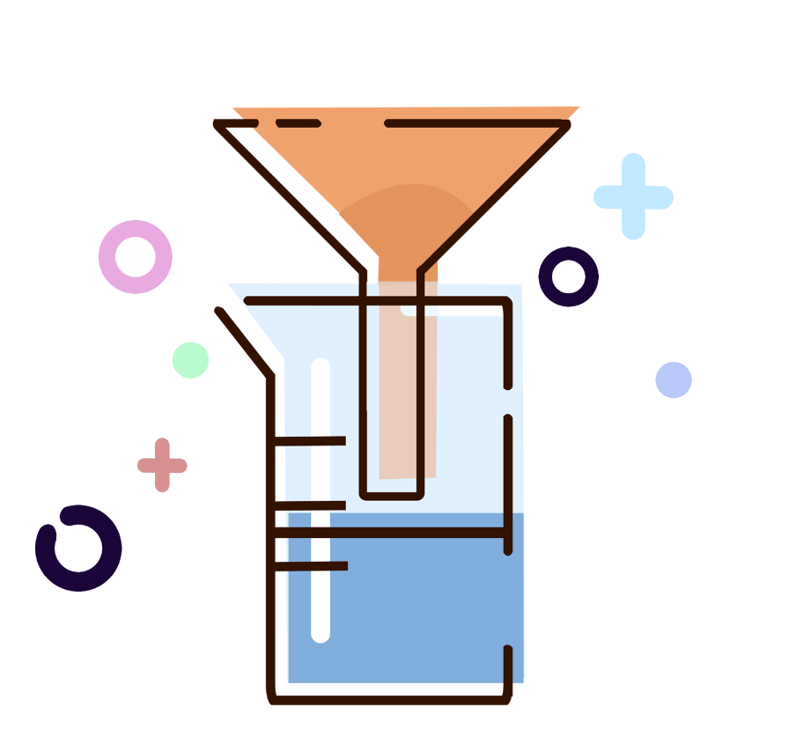
Introduction
The Toxin and Toxin Target Database (T3DB), or, soon to be referred as, the Toxic Exposome Database, is a unique bioinformatics resource that combines detailed toxin data with comprehensive toxin target information. The database currently houses 3,678 toxins described by 41,602 synonyms, including pollutants, pesticides, drugs, and food toxins, which are linked to 2,073 corresponding toxin target records.
The focus of the T3DB is on providing mechanisms of toxicity and target proteins for each toxin. This dual nature of the T3DB, in which toxin and toxin target records are interactively linked in both directions, makes it unique from existing databases. It is also fully searchable and supports extensive text, sequence, chemical structure, and relational query searches. It is both modelled after and closely linked to the Human Metabolome Database (HMDB) and DrugBank

Slide 4
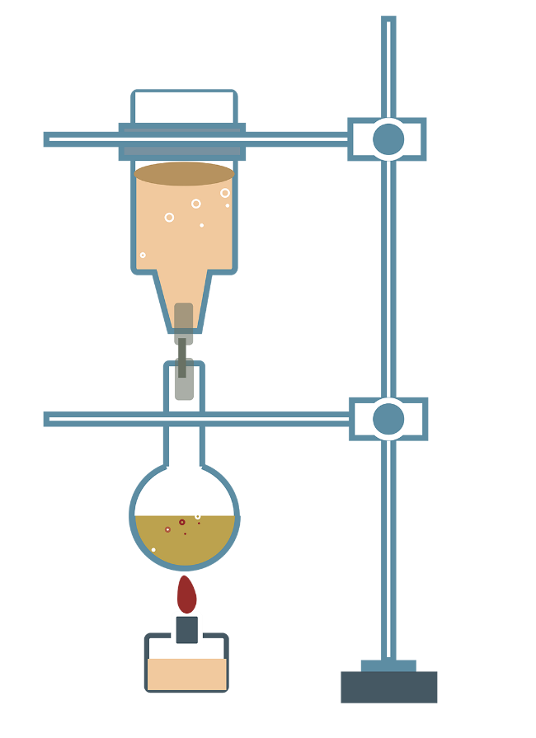
Toxins and Toxin Target Database

Slide 5

Database Tables
Contains all the toxin techniques to poison targets
All toxin
data
Toxin structure
Relations
All toxin
target
FASTA files Protein Sequences, Gene Sequences available in the link
All toxins , their description and chemical formula and pathways
Mechanisms
contains full records about each toxin and its targets with the mechanisms used and connect data with each other
Substances that the toxin chemically binds to

Slide 6

Relations

Slide 7

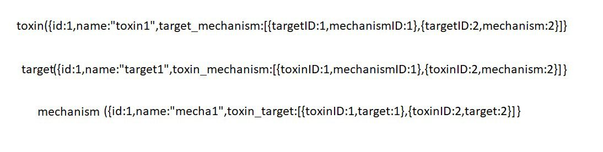
Relations
Primary View of Our Database Relation

Slide 8
Flexible Schema

Slide 9
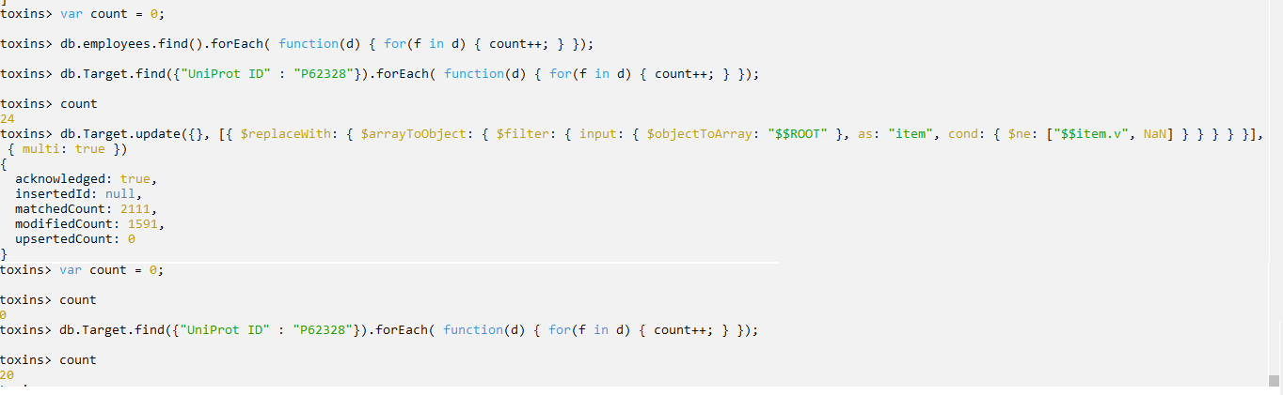
Power of Flexible Schema

Slide 10
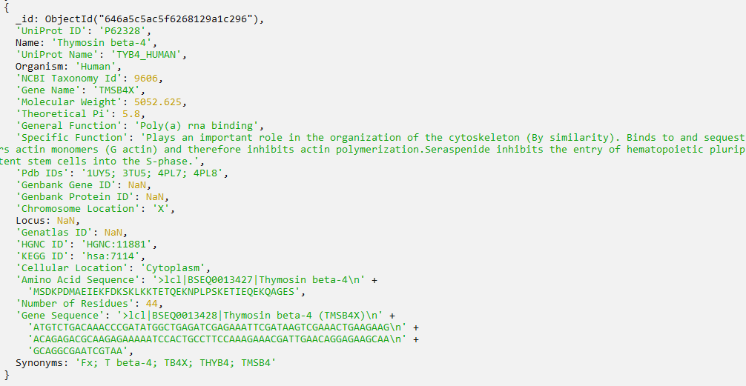


4 NaN fileds

Slide 11
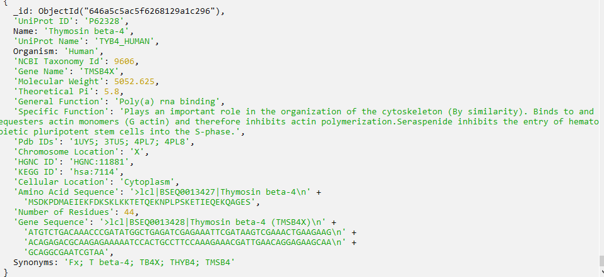
0 NaN fileds
The guarantee for the smooth

Slide 12
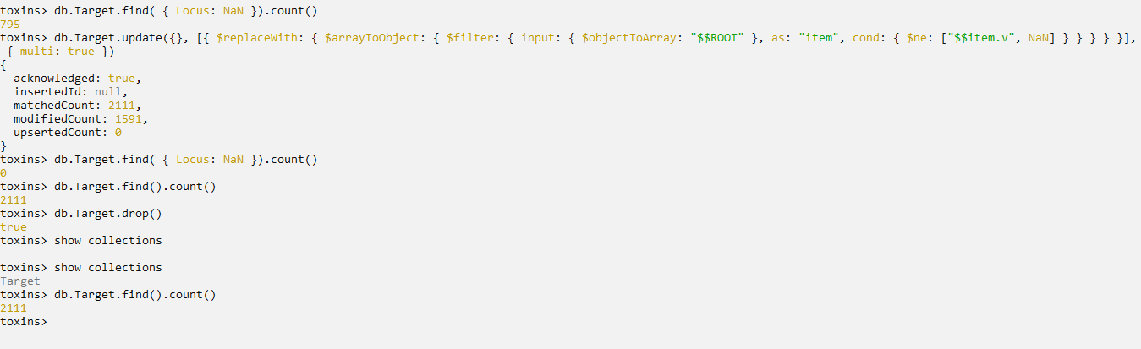
Works well only wanted records is affected

Slide 13
Data cleaning with OpenRefine

Slide 14

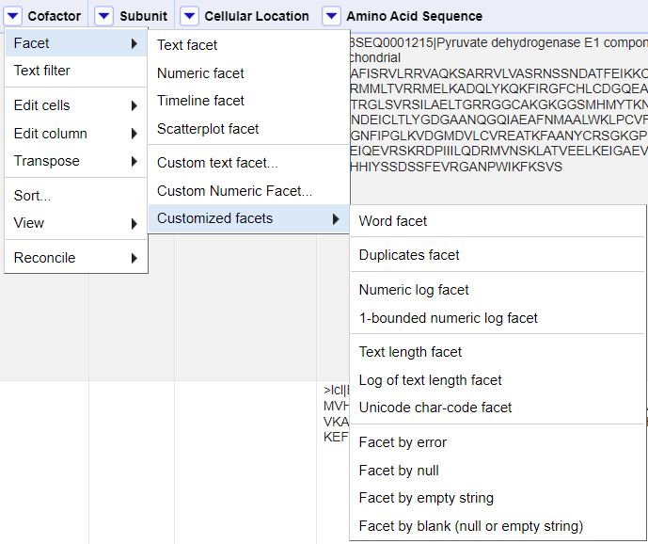
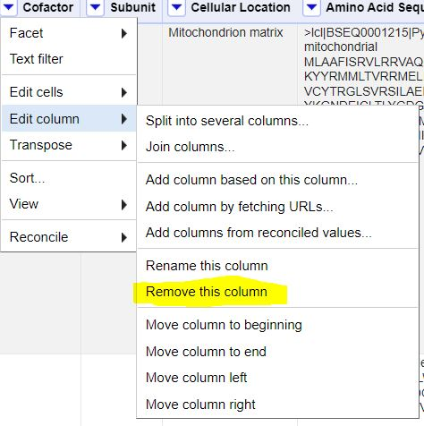
Remove Blank Columns

Slide 15
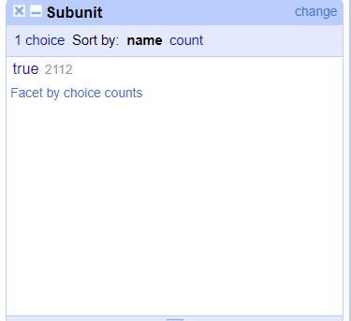
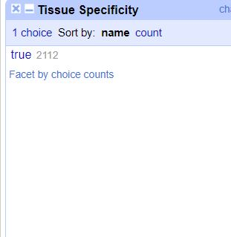
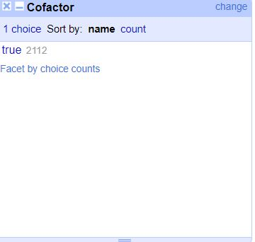
Facet by blank Results

Slide 16
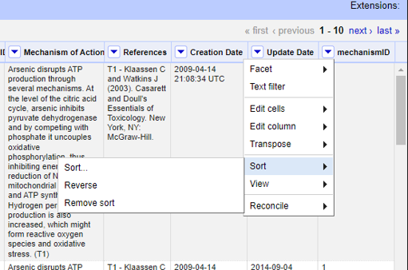
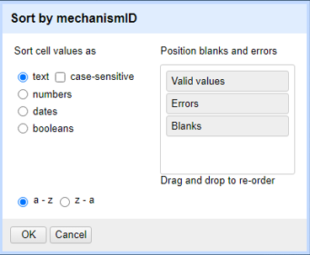
Remove Duplicates

Slide 17
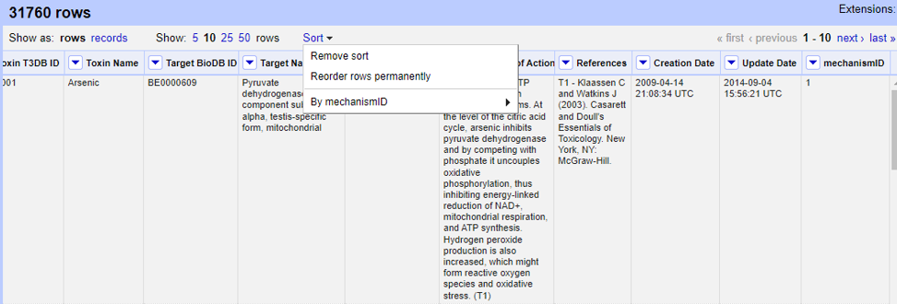
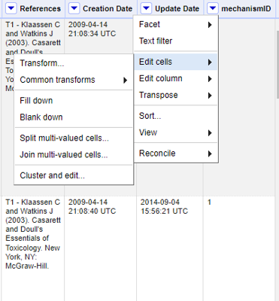
Blank down duplicates after sorting

Slide 18
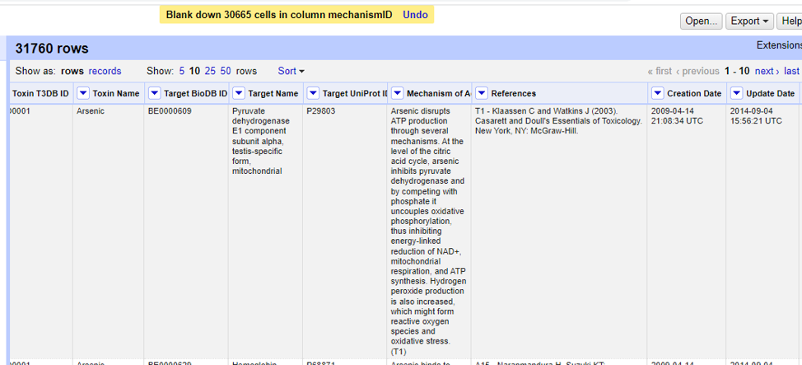
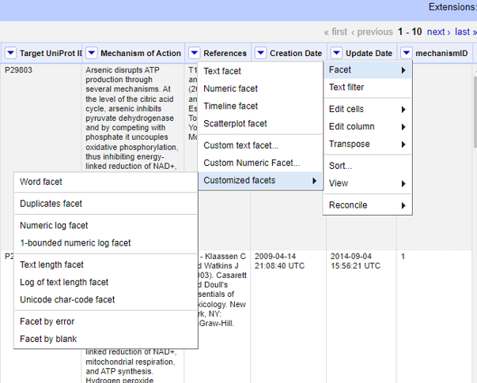
Remove blanked duplicates

Slide 19
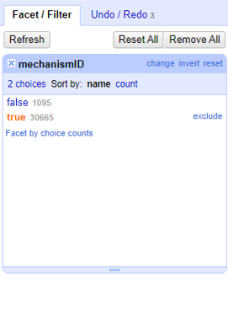
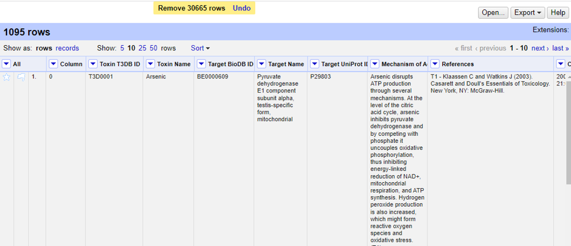
Cleaned Data

Slide 20
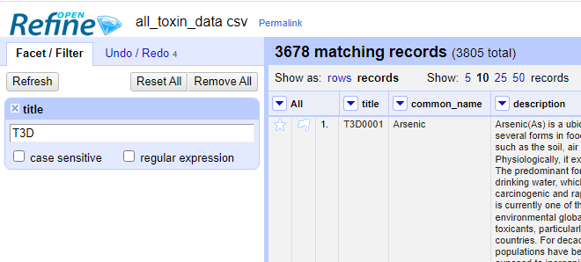
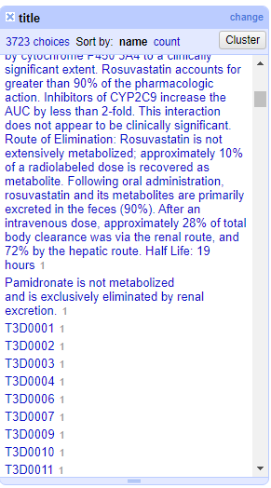
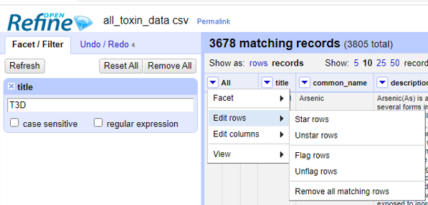
Remove Noise from ID

Slide 21
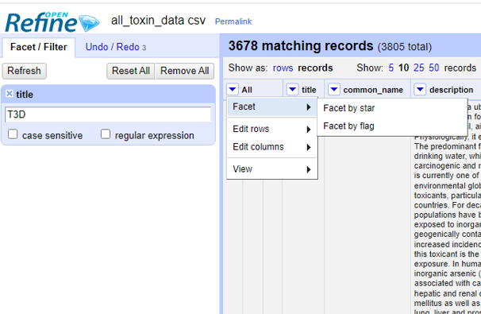
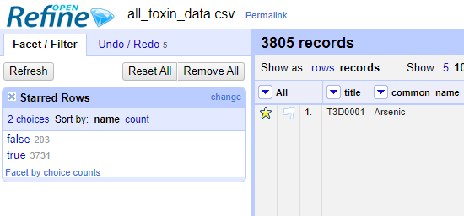
Star Correct IDs

Slide 22
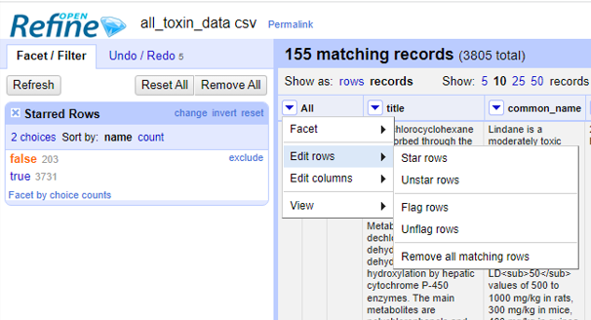
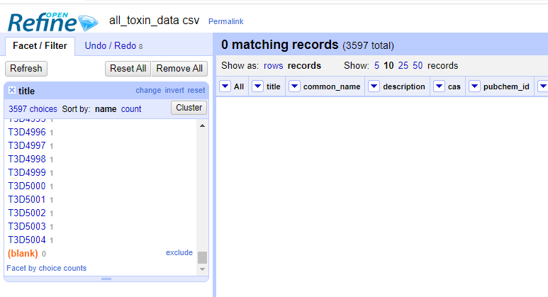
Remove Unstarred

Slide 23
Connecting MongoDB With Python

Slide 24

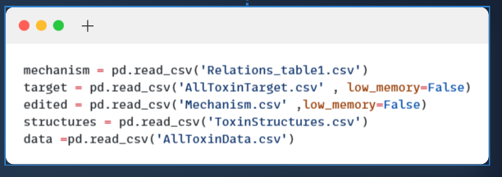

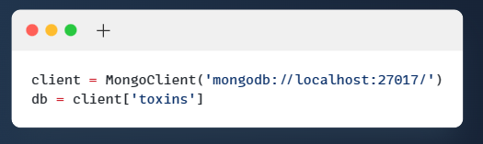
Connecting database and reading the collections

Slide 25
QUREIES

Slide 26

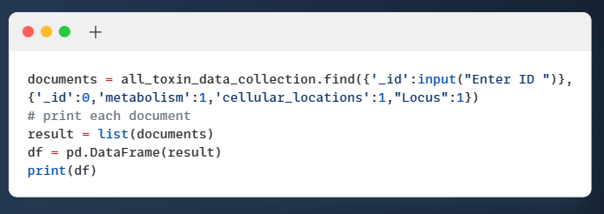
Find
Find Query to return a metabolism and the cellular location where the toxin has an effect and More detailed location of the chromosomal position of the toxin target according to toxin id.

Slide 27
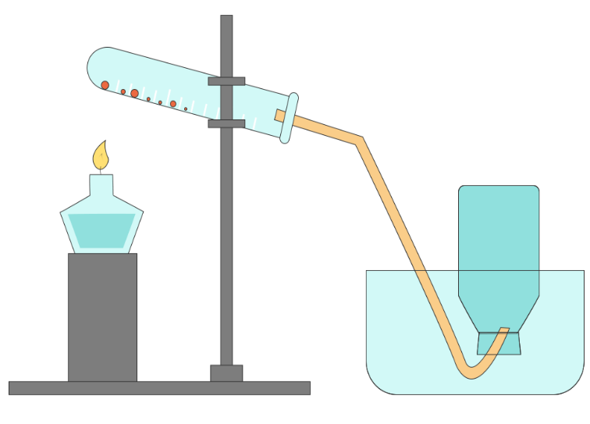
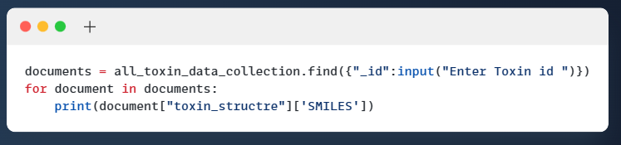
Find
Find Query to return a Canonical SMILES string that corresponding to toxin structure of specific toxin according to its id.

Slide 28
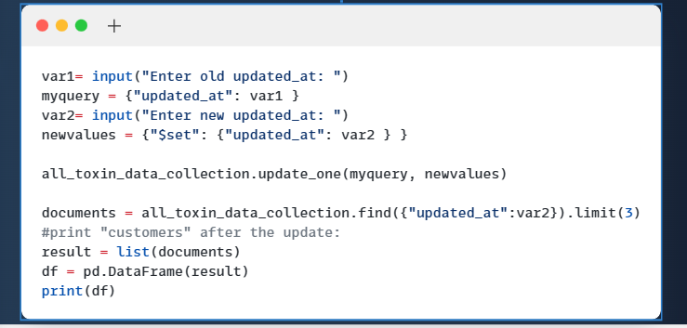
Update
Update Query to replace the last updated date of the toxin access in the database

Slide 29
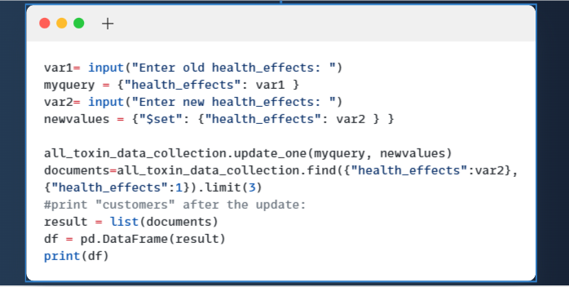
Update
Update Query to replace the old health effect with a new one to add new information amount The long term physiological deficiencies, damage or problems caused by the toxin

Slide 30
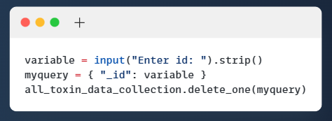
Delete
Delete Query to remove specific toxin according to its id.

Slide 31
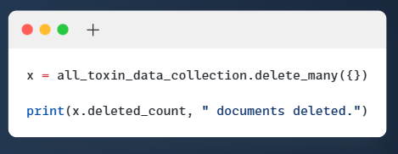
Delete
Delete Query to remove All toxin data.

Slide 32
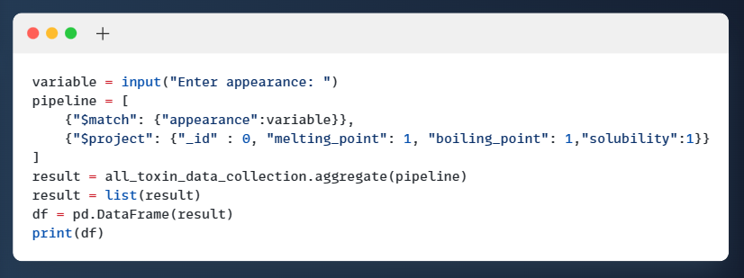
Aggregate
Query to aggregate the melting point and boiling point and solubility of a specific toxin according to its Outward or visible aspect of the it.

Slide 33
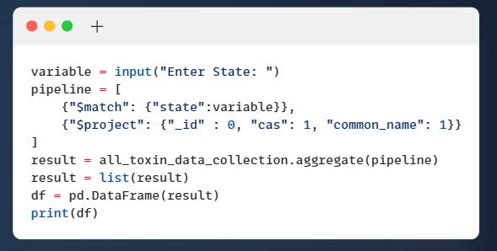
Aggregate
Query to aggregate Chemical Abstracts Service (CAS) Number and toxin name according to toxin state Solid , Gas or Liquid.

Slide 34
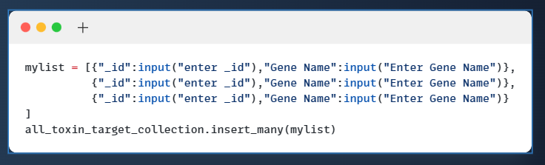
Insert
Query to insert new id and gene name in the target collection

Slide 35
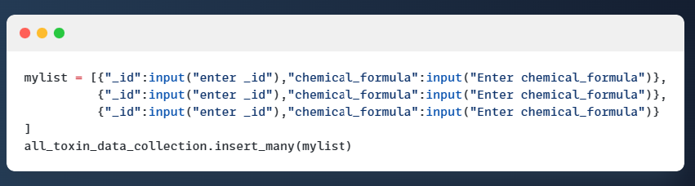
Insert
Query to insert new id and chemical formula of specific toxin in the data collection

Slide 36
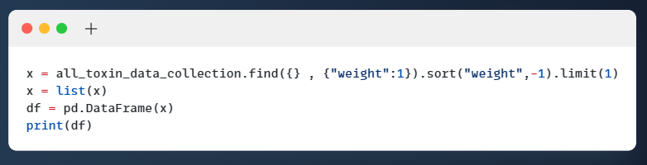
Maximum
Query to return the max weight of all toxins

Slide 37
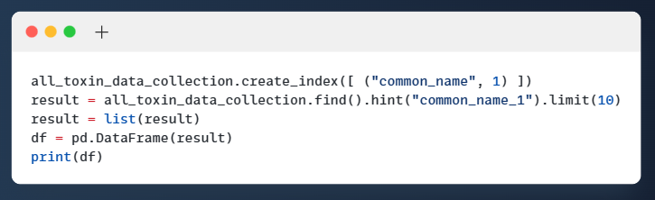
Indexing
Query of indexing with the common name of the toxin

Slide 38
Graphical User Interface

Slide 39

Thanks

